Slide 1
DEEP LEARNING FRAME WORKS FOR SUPER IMAGE RESOLUTION

Slide 2
CONTENTS
Abstract
Introduction
Existing system
Proposed system
Architecture
Modules
Conclusion

Slide 3
ABSTRACT:
Our strategy straightforwardly learns a start to finish mapping between the low/high-resolution pictures. The mapping is spoken to as a Deep convolutional neural system (CNN) that takes the low-resolution picture as the information and yields the high-resolution one

Slide 4
EXISTING SYSTEM:
Image Super resolution has been implemented in several different ways using Technologies like MATLAB. The system show a acceptable accuracy for image super resolution by implementing Neural Networks in the system.
DISADVANTAGES:
The existing systems are implemented on MATLAB and hence are not opensource.
It takes up more resources and overall gives less accuracy

Slide 5
PROPOSED SYSTEM:
In our proposed system, Python based Deep learning algorithms are being implemented for making Super Resolution images using a Low-resolution image. The System is using Convolutional Neural Network for doing the task.
ADVANTAGES:
Usage of Machine Learning Algorithm makes the system more reliable and accurate.
Convolutional Neural Network algorithm is implemented.

Slide 6
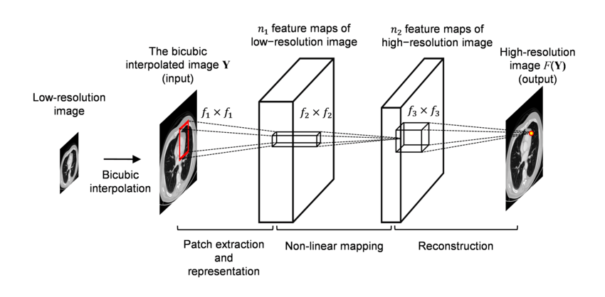
ARCHITECTURE:

Slide 7
MODULES:
TENSORFLOW
MATPLOTLIB
OPEN CV
NUMPY
SKIMAGE

Slide 8
CONCLUSION:
The proposed approach, SRCNN, learns an end-to-end mapping between low- and high-resolution images, with little extra optimization. With a lightweight structure, the SRCNN has achieved superior performance than the state-of-the-art methods.
We conjecture that additional performance can be further gained by exploring more ﬁlters and different training strategies

